Slide 1
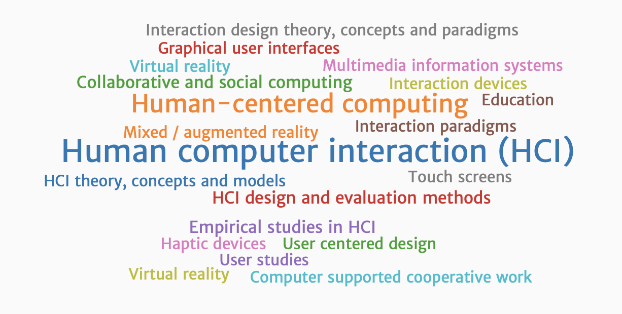

Slide 2
HCI (human-computer interaction) is the study of how people interact with computers and to what extent computers are or are not developed for successful interaction with human beings. As its name implies, HCI consists of three parts: the user, the computer itself, and the ways they work together.

Slide 3
User
By "user", we may mean an individual user, a group of users working together. An appreciation of the way people's sensory systems (sight, hearing, touch) relay information is vital. Also, different users form different conceptions or mental models about their interactions and have different ways of learning and keeping knowledge and. In addition, cultural and national differences play a part.

Slide 4
Computer
When we talk about the computer, we're referring to any technology ranging from desktop computers, to large scale computer systems. For example, if we were discussing the design of a Website, then the Website itself would be referred to as "the computer". Devices such as mobile phones or VCRs can also be considered to be “computers”.

Slide 5
Interaction
There are obvious differences between humans and machines. In spite of these, HCI attempts to ensure that they both get on with each other and interact successfully. In order to achieve a usable system, you need to apply what you know about humans and computers, and consult with likely users throughout the design process. In real systems, the schedule and the budget are important, and it is vital to find a balance between what would be ideal for the users and what is feasible in reality.

Slide 6
The Goals of HCI
The goals of HCI are to produce usable and safe systems, as well as functional systems. In order to produce computer systems with good usability, developers must attempt to:
understand the factors that determine how people use technology
develop tools and techniques to enable building suitable systems
achieve efficient, effective, and safe interaction
put people first

Slide 7
Factors in HCI
There are a large number of factors which should be considered in the analysis and design of a system using HCI principles. Many of these factors interact with each other, making the analysis even more complex. The main factors are listed in the table below: Organisation Factors Training, job design, politics, roles, workorganisation Environmental Factors Noise, heating, lighting, ventilation Health and Safety Factors The User Cognitive processes and capabilities Motivation, enjoyment, satisfaction, personality, experience

Slide 8
Comfort Factors Seating, equipment, layout. User Interface Input devices, output devices, dialogue structures, use of colour, icons, commands, navigation, graphics, natural language, user support, multimedia, Task Factors Easy, complex, novel, task allocation, monitoring, skills Constraints Cost, timescales, budgets, staff, equipment, buildings System Functionality Hardware, software, application Productivity Factors Increase output, increase quality, decrease costs, decrease errors, increase innovation

Slide 9
Disciplines contributing to HCI
The field of HCI covers a wide range of topics, and its development has relied on contributions from many disciplines. Some of the main disciplines which have contributed to HCI are:
Computer Science o technology o software design, development & maintenance o User Interface Management Systems (UIMS) & User Interface Development Environments (UIDE) o prototyping tools o graphics
Cognitive Psychology o information processing o capabilities o limitations o cooperative working o performance prediction

Slide 10
Social Psychology o social & organizational structures
Ergonomics/Human Factors o hardware design o display readability
Linguistics o natural language interfaces
Artificial Intelligence o intelligent software
Philosophy, Sociology & Anthropology o Computer supported cooperative work (CSCW)
Engineering & Design o graphic design o engineering principles

